Slide 1
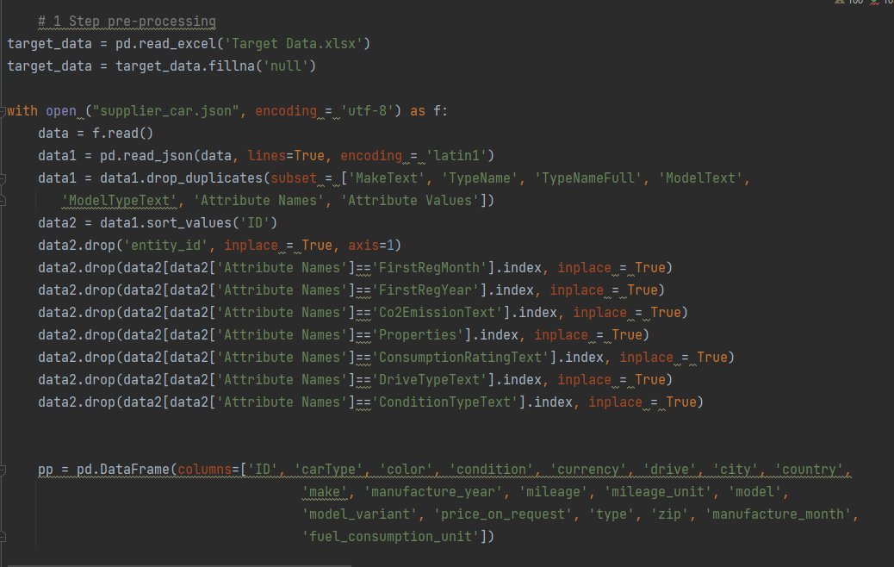
Step Pre – processing (1)
Character encoding
Removing duplicate rows in subset columns
Sorting by ID for better readability
Dropping unnecessary attributes that
we do not have in target data
Creating new dataframe with the
same columns as in target schema

Slide 2
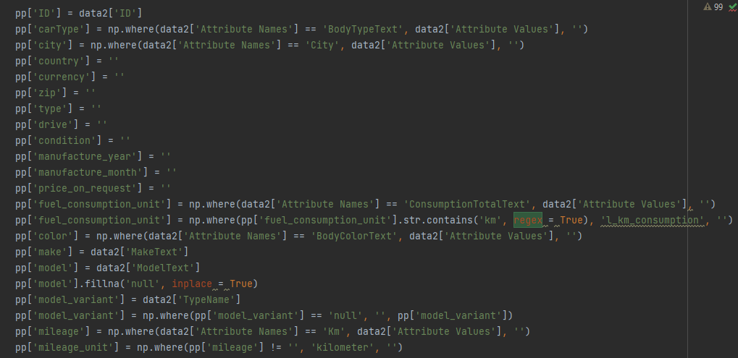
Step Pre – processing (2)
Assigning empty string since we do not
have any data for these columns
Assigning attribute value if
attribute name (column name) is true
Creating new columns that match with
columns in supplier column (different names)
Assigning empty string to model_variant
if the value is ‘null’
Assigning ‘kilometer’ if we have
mileage (only kilometer unit provided)

Slide 3
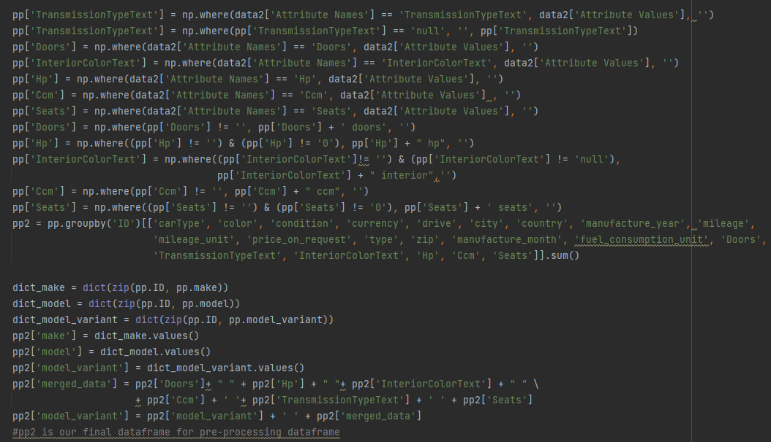
Step Pre – processing (3)
Assigning attribute value if
attribute name (column name) is true
Assigning names of columns for each
value in order to merge those values
in merged_data column
Grouping by ID and
applying sum function
Creating dictionaries where our keys are ID numbers and values are make / model / model_variant. By doing this, we will easily match values with IDs.
Creating new column which will merge stated values
for each row so we could merge this new column with model_variant.
This is done in order to follow data schema of target dataset where those attributes are added after model_variant values.

Slide 4
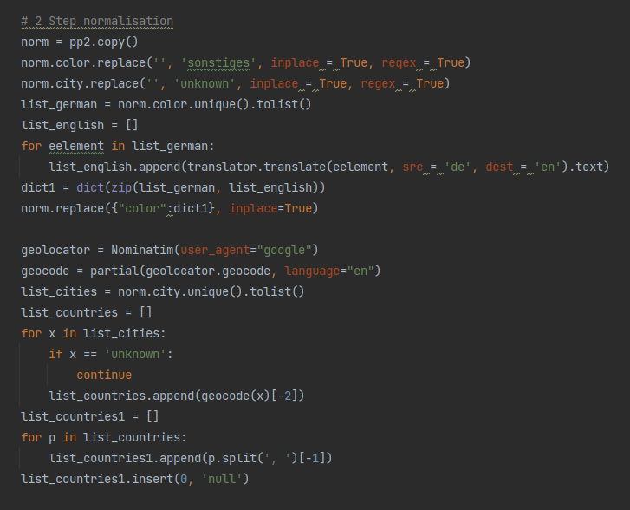
Step Normalization (1)
Using google translate API in order to translate colors from German to English
Matching cities with countries
using GeopPy Nominatim
Onedot AG
Badenerstrasse 47
CH-8004 Zürich
+ 41 44 585 22 05
onedot.com

Slide 5
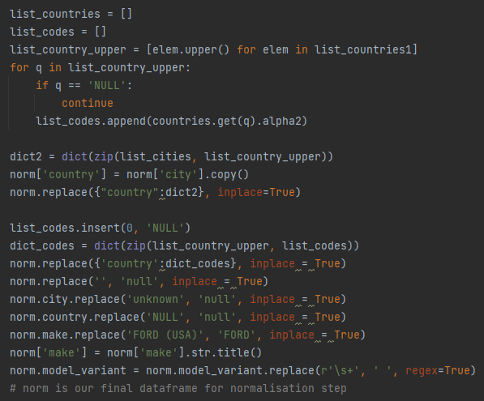
Step Normalization (2)
Creating list of country codes using list of ISO 3116 countries
Creating dict where keys are cities and
values are countries
Creating dict where keys are countries and
values are country codes
Replacing stated values in order to follow target dataset
set schema (how the missing values and FORD are entered)
Onedot AG
Badenerstrasse 47
CH-8004 Zürich
+ 41 44 585 22 05
onedot.com
Removing multiple spaces in model_variant column

Slide 6
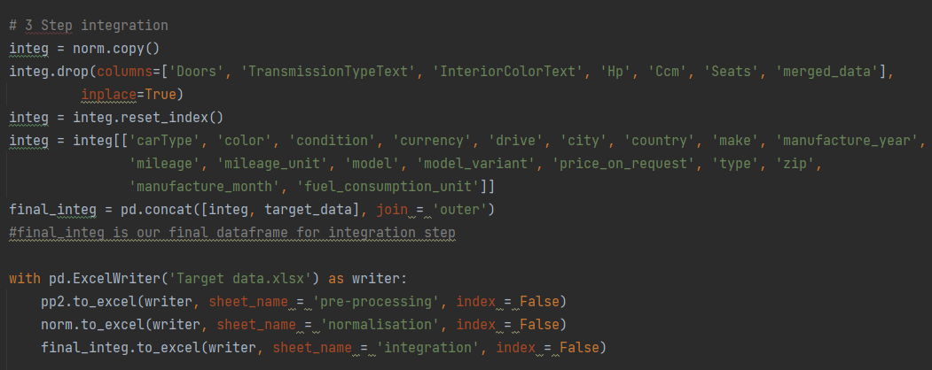
Step Integration (1)
Dropping unnecessary columns
Ordering columns of integ dataframe
Concating integ dataframe with target_dataset
In order to load them directly without any changes
(target dataset)
Loading dataframes of each step to
different sheets in target dataset

Slide 7
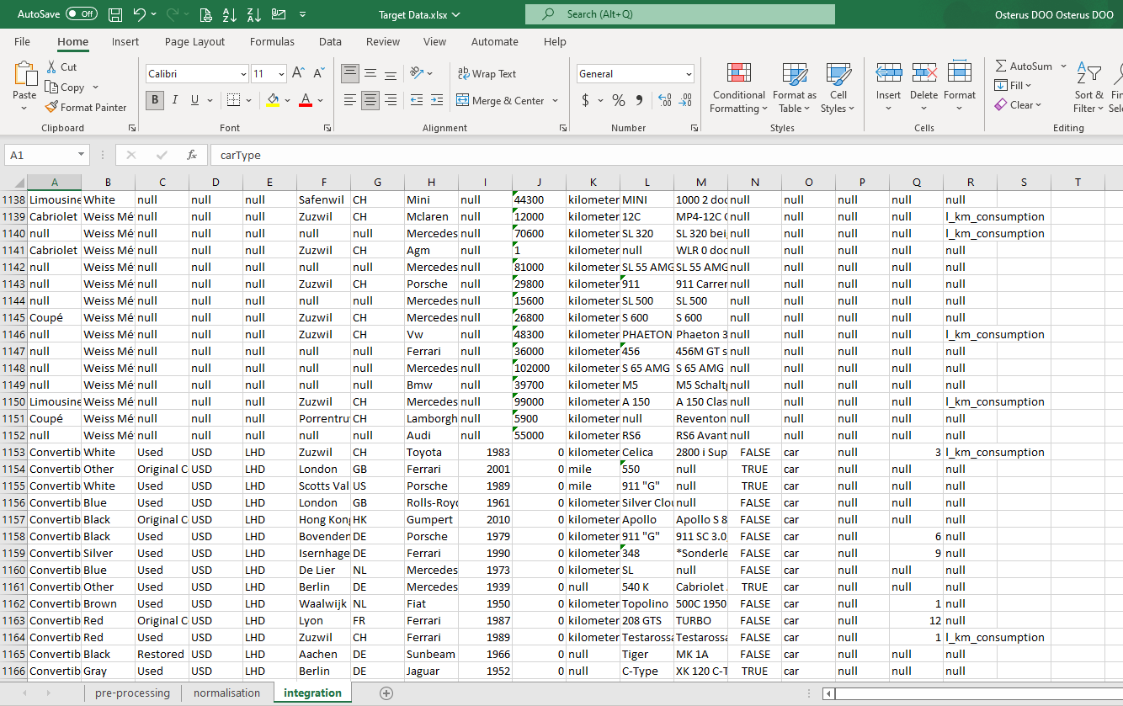
Step Integration (2)
Structured, normalized and processed
supplier data
Target data

Slide 8
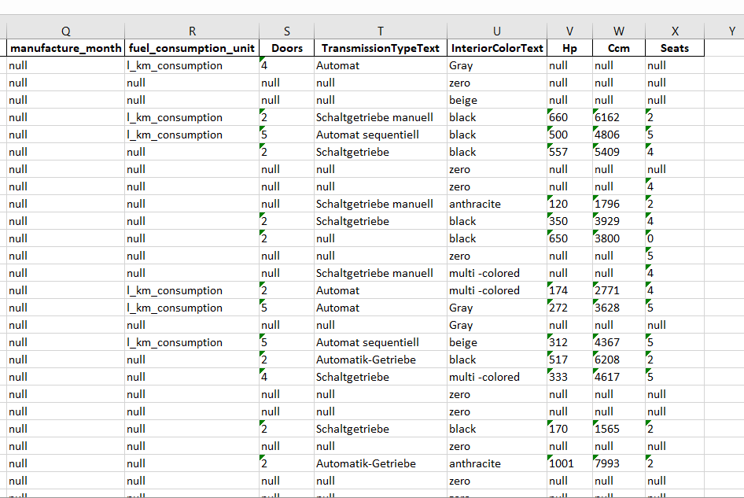
Changes that can be applied to the input data
For the sake of readability we can
create new columns for following attributes:
Doors
TransmissionTypeText
InteriorColorText
Hp
Ccm
Seats

Slide 9
Take-away message
Please provide us with data for following columns in order to fully integrate all data that exist in Target Data schema:
1. Currency – although normalization is possible using ISO 4217 currency codes. This process is skipped since
currency data in target data set is not normalized by country.
(e.g. if country Switzerland then currency USD instead of CHF)
2. Drive (required normalization e.g. 1 –RHD , 0 – LHD)
3. Price_on_request (required normalization e.g. 1 – True, 0 – False)
4. Zip – although normalization is possible using geopy library, zip code values in target data
do not align with zip codes of cities. (e.g. if city Zurich then currency zip is null instead of 8000)

